Slide 1

Asset-Liability study
New Mexico educational retirement board
december 2022
Robert Goldthorpe, ASA, Investment Director

Slide 2
New Mexico educational retirement board
Executive summary
NMERB remains in a poor funded position though steps have been made to improve going forward
  NEPC estimate of June 30, 2022 funded status:
    Actuarial Basis: 64.0%
    Market Basis: 65.3%
  Employer contribution rate increased to 15.15% in FY2022, 17.15% in FY2023 and 18.15% in FY2024
Assumed financial measurements for June 2022 are mixed since 2019 AL Study
  Projected Funded Status: from 63% to 64%
  Average 10 year Cashflow Projection: from -4.1% to -3.8%
  Expected Date of Full Funding: from 2045 to 2049
Market Environment has shifted significantly
  Challenging investment environment in 2022
    FYTD investment returns: -2.9% returns
  From low rates/low growth/low expected returns…
  To higher inflation, challenging market conditions, tightening monetary policy
Well-diversified, long-term approach remains appropriate for achieving full-funding

Slide 3
Purpose & Methodology of AL Study

Slide 4
Purpose of Asset-Liability Study
Review the current/projected financial status of the plan over long-term horizon
Determine appropriateness of current asset allocation with consideration of:
  Expected progress of liabilities and cash flows/liquidity needs
  Path of funded status
Test sensitivity of plan (Assets and Liabilities) to various range of outcomes
  Market performance across range of economic environments
  Contribution volatility
  Range of liquidity environments
Consider appropriate asset mixes and expected return on assets
  Assess return target against tradeoff of volatility/range of outcomes
  Analyze inclusion/exclusion of various asset classes/strategies

Slide 5
First Principles
The funding of pension benefits is made possible through the combination of member and employer contributions and returns on investment
The long-term expected return on assets drives the selection of an appropriate interest rate for discounting public pension liabilities
Expected Return on Assets is based on assumptions – actual experience will likely depart from those assumptions
Long-term nature of pension obligations positions well-funded pension plans to take advantage of long-term investment opportunities
It is critical and healthy for pension trustees to regularly review fundamental characteristics of the pension plan:
  Risk tolerance
  Viability of long-term investment return
Risk is multi-dimensional and should be considered from different perspectives – Risk is not just volatility!
  Volatility, Potential for drawdowns, Illiquidity, Exposure to economic factors, etc.
Return expectations are generally lower than historical returns, forcing many investors to reconsider both return expectations and appropriate levels of risk

Slide 6
Balancing the Pension Equation
All the complexities of pension plans boil down to the classic equation:
Contributions (C) plus Investment Earnings (I) must equal all Benefits (B) and Expenses (E)
  C + I = B + E
Plan Factor | Flexibility/Constraint
(C) Contributions | NMERB contribution model offers little flexibility to balance equation: Level employer percent of pay contributions (17.15 increasing to 18.15%) Recommended contribution rate is currently 19.21% Changing contribution rate requires legislative action
(B + E) Benefits & Expenses | Lower “C” and/or “I” can be offset with an equivalent reduction in outflows: Vested benefits generally cannot be reduced Non-vested benefits can be reduced, but challenging on many levels Political, paternal, generational equity, etc.
(I) Investment Return | Investment pool can be restructured to maintain target return Increase risk and/or portfolio efficiency Expected return (and risk level) could be scaled down over time as funded status improves allowing for maintenance of long-term plan stability Low annual returns (below expectations) require adjusting other levers Higher Contributions or longer amortization to full funding Higher Investment Returns in later years

Slide 7
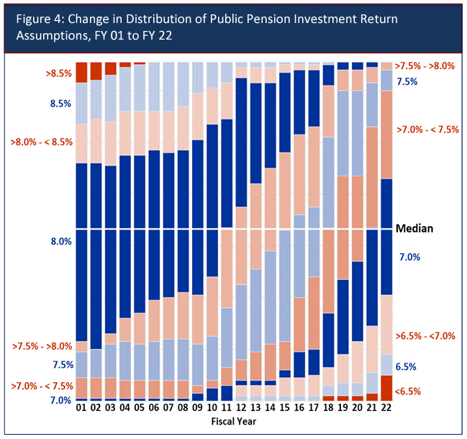
Expected Return
Expected return and liability discount rate are closely linked for public pension plans
  Corporate DB: stringent regulations
  Going-concern of government entities has historically provided comfort in public plans taking longer term approach
  Expected returns are forward-looking
Historical market environment has led to downward trend in EROAs for public pensions
  Median 2022 EROA = 7%
Low expected returns put pressure on assumptions and outcomes but…
  Market re-pricing and higher inflation may push return expectations higher looking forward
Source: NASRA
Source: GRS, NEPC

Slide 8
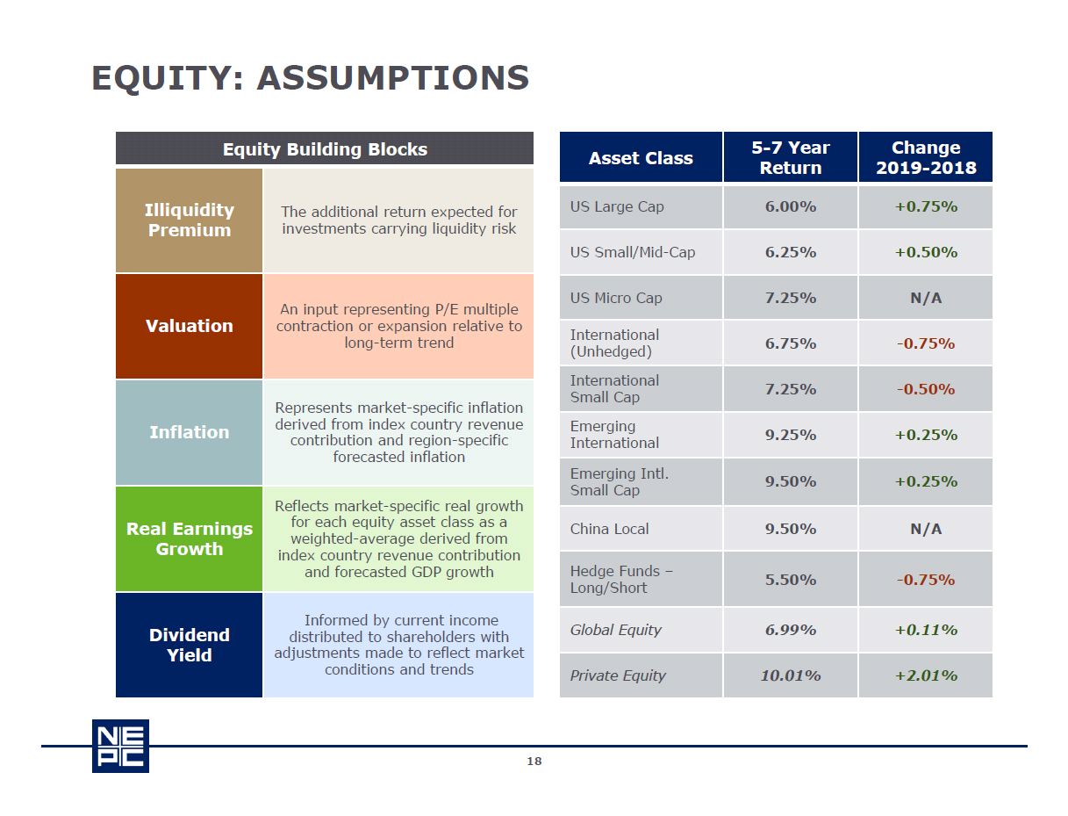
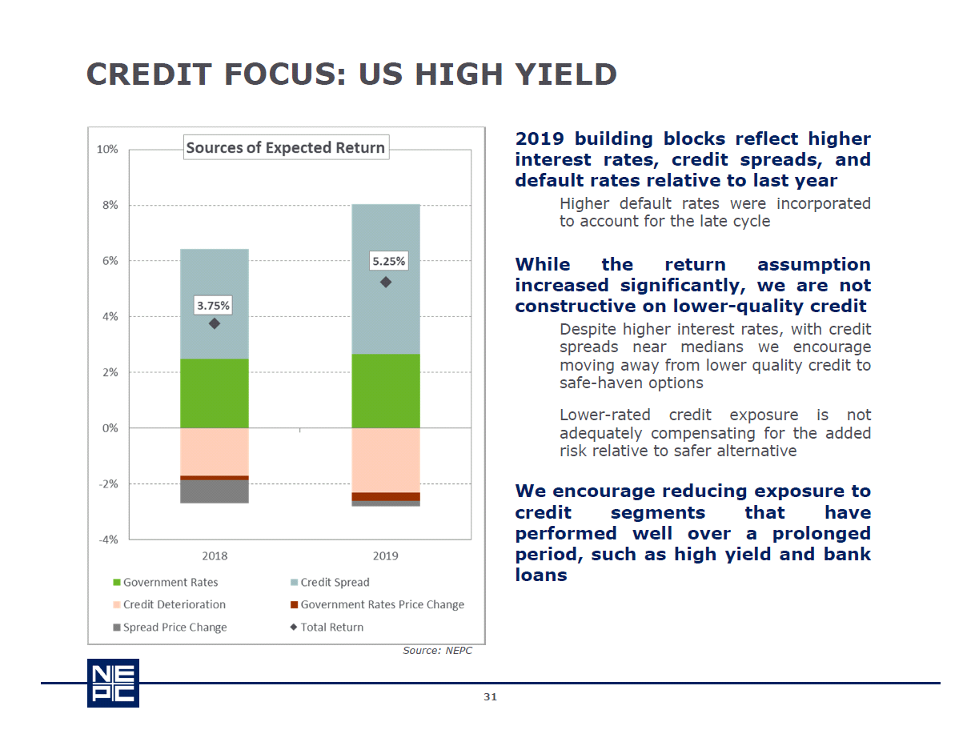
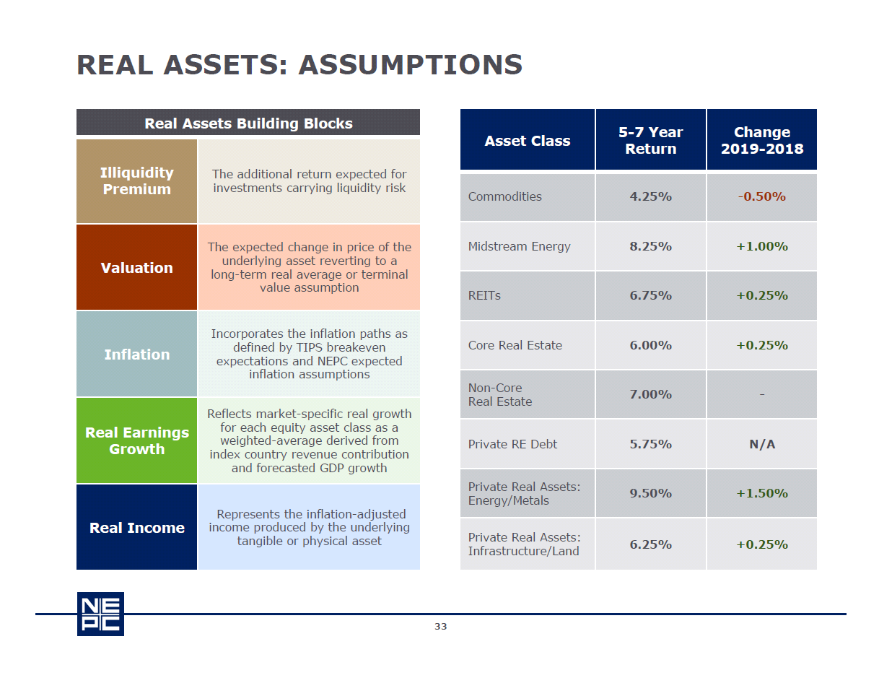
Assumption Setting Process
Forward-looking analysis is based on current market pricing and a building blocks approach
  Return = yield + price change (valuation, defaults)
  Key economic observations (inflation, real growth)
  Structural themes
Assumptions prepared by Asset Allocation Committee and reviewed and approved by Partners Research Committee
  Assumptions updated annually
  Same assumptions used for all clients

Slide 9
Methodology for Asset-Liability Study
Gather information on assets and liabilities
  Assets (information provided by NEPC)
    Current Asset Allocation targets
    Assumptions for Asset Class projections (return/risk/correlation)
    Liquidity of underlying investments
  Liabilities (information provided by GRS)
    Current Valuation of plan
    Current Plan Provisions
    Assumptions underlying valuation of liabilities
    Projection of expected future cashflows
Determine other asset allocation mixes appropriate for analysis
Run long-term projections to understand asset-liability dynamics
  Deterministic Forecasting – baseline projections of assets, liabilities, and cashflows
  Stochastic Forecasting – projections based on range of forecasts, ranked to understand probabilities/likelihood of different plan outcomes

Slide 10
Methodology (continued)
Apply multiple perspectives/tools to build robust, objective driven asset allocation solutions
  Mean-variance optimization – identifying highest return portfolio at each level of volatility
    Range of portfolios is the “Efficient Frontier”
  Risk budgeting – understanding the risk allocation and not simply capital allocation of portfolio
  Scenario Analysis – stress tests of plan dynamics in various economic environments
  Liquidity Analysis – stress test portfolio liquidity in adverse liquidity scenario
Engage in conversation/analysis/iterations to determine various factors
  Risk Tolerance
  Expected Return
  Contribution/Funded Status Dynamics
  Implications of Changes
Discuss results and determine next steps

Slide 11
Background

Slide 12
Key Assumptions
Asset, Liability Values and Return assumptions
  Relied on values provided in GRS June 30, 2022 Valuation Report
  2022 FYTD (September 30) plan asset return of -2.9%
  10-year and 30-year NEPC assumptions used for projections
Discount rate assumption: 7.0%
Expected contributions
  Employer contributions are assumed to be equal to the statutory contribution of 17.15% in 2023 and 18.15% thereafter
  Employee contributions are assumed to be 10.70% of payroll each year
Population and benefit growth
  Active population is expected to remain level (departures are filled with new entrants)
  Active population accrues new benefits each year
  Active payroll expected to increase 3.00% per year
  Open group assumptions as described in the valuation report

Slide 13
New Mexico educational retirement board
Plan characteristics
The plan offers a traditional final average pay benefit
  Final average compensation times benefit percentage times years of service
Typical for a mature pension plan, retirees and inactives outnumber actives
  Retirees and inactives are 52% of participants and 66% of the liability
As of June 30, 2021 the plan was 62.8% funded on an actuarial basis
  70.3% funded on a market value basis
Investment performance has outperformed the liability discount rate on average over the last 5 years
  10.9% market return
  7.7% smoothed actuarial return
The Current Policy allocation is expected to achieve the liability discount rate
  30-yr expected return of 7.5% vs. 7.0% liability discount rate

Slide 14
New Mexico educational retirement board
Asset-Liability profile
Funded Status History
Asset Allocation
Liability Discount Rate | 7.00%
Funded Ratio – Actuarial Value Basis | 64.0%
Funded Ratio – Market Value Basis | 65.3%
Expected Return on Assets (10 years) | 6.5%
Expected Return on Assets (30 years) | 7.5%
Asset Volatility | 14.1%

Slide 15
ALM study oVerview

Slide 16
New Mexico educational retirement board
10-year funded status projection

Slide 17
New Mexico educational retirement board
10-year stochastic funded status

Slide 18
New Mexico educational retirement board
10-year contribution projection

Slide 19
New Mexico educational retirement board
10-year Statutory Funding period projection

Slide 20
New Mexico educational retirement board
10-yr Net Cash flow projection

Slide 21
New Mexico educational retirement board
30-yr funded status projection

Slide 22
New Mexico educational retirement board
30-yr contribution projection

Slide 23
New Mexico educational retirement board
30-year Statutory Funding period projection

Slide 24
New Mexico educational retirement board
30-yr net cash flow projection

Slide 25
Asset allocation

Slide 26
New Mexico educational retirement board
Alternative asset allocations

Slide 27
New Mexico educational retirement board
Allocation of risk
Asset Allocation
Asset Risk

Slide 28
New Mexico educational retirement board
10-year Median funded status projection

Slide 29
New Mexico educational retirement board
Economic scenarios

Slide 30
appendix

Slide 31
New Mexico educational retirement board
Assumptions and methods
Deterministic and stochastic return projections are based on NEPC’s 12/31/2021 capital market assumptions
  Reflects 1.0% return for FYE June 30, 2022 and -2.9% return thru 9/30/2022Assumed -15% YTD return thru 9/30/2022 (-12.7% actual YTD return thru 6/30/2022)
  Thereafter, NEPC’s 10-year & 30-year return assumption used for asset return projections
Asset-liability projections follow a roll-forward methodology based on the June 30, 2021 Actuarial Valuation Report produced by GRS
  Benefit payment projections provided by GRS
  Other than those described herein, all assumptions remain unchanged from the valuation
  No gains or losses are assumed other than those attributed to investment experience
Employer and member contribution based on flat percentage of pay
  Employer contribution rate set at 17.15% for 2023 and 18.15% for 2024 and thereafter
  Member contribution rate set at 10.70%
Funding period reflects the number of years required to fully fund the plan given the employer and contribution rates

Slide 32
12/31/2021 capital market assumptions
 | Asset Class | 10-Year Return | 30-Year Return | Standard Deviation
MACRO | Inflation | 2.4% | 2.5% | —
 | Cash | 1.5% | 2.3% | 0.6%
 | US Leverage Cost | 1.9% | 2.7% | 0.6%
 | Non-US Cash | 0.4% | 1.4% | 0.6%
EQUITY | US Large-Cap Equity | 0.6% | 1.6% | 16.6%
 | US Small/Mid-Cap Equity | 4.3% | 6.1% | 20.7%
 | Non-US Developed Equity | 5.6% | 6.6% | 19.6%
 | Non-US Developed Equity (USD Hedge) | 5.2% | 6.2% | 17.6%
 | Non-US Developed Small-Cap Equity | 5.4% | 6.4% | 24.2%
 | Emerging Market Equity | 5.9% | 6.8% | 28.3%
 | Emerging Market Small-Cap Equity | 8.3% | 8.7% | 34.4%
 | Global Equity* | 7.6% | 8.7% | 17.9%
 | Hedge Fund – Equity | 5.4% | 6.8% | 11.4%
 | Private Equity – Buyout | 4.1% | 5.2% | 19.0%
 | Private Equity – Growth | 7.3% | 8.5% | 31.5%
 | Private Equity – Venture | 8.6% | 9.7% | 45.0%
 | Private Equity – Secondary | 10.0% | 10.7% | 20.0%
 | Non-US Private Equity | 6.8% | 7.9% | 32.0%
 | Private Equity* | 10.3% | 10.7% | 25.2%
 | China Equity | 8.99% | 10.0% | 28.6%
 | US Microcap Equity | 8.8% | 8.8% | 25.8%

Slide 33
12/31/2021 capital market assumptions
 | Asset Class | 10-Year Return | 30-Year Return | Standard Deviation
CREDIT | US TIPS | 1.4% | 2.6% | 5.8%
 | US Treasury Bond | 1.5% | 2.5% | 5.3%
 | US Corporate Bond | 2.8% | 4.2% | 7.3%
 | US Mortgage-Backed Securities | 1.8% | 2.8% | 6.5%
 | US Aggregate Bond* | 2.0% | 3.1% | 5.6%
 | US High Yield Corporate Bond | 3.2% | 5.4% | 11.2%
 | US Leveraged Loan | 4.7% | 5.6% | 9.1%
 | Emerging Market External Debt | 4.1% | 5.1% | 13.0%
 | Emerging Market Local Currency Debt | 5.7% | 5.3% | 13.0%
 | Non-US Government Bond | 1.1% | 1.9% | 9.3%
 | Non-US Government Bond (USD Hedge) | 1.3% | 2.2% | 4.0%
 | Global Government Bond* | 1.2% | 2.2% | 7.6%
 | Global Government Bond (USD Hedge)* | 1.3% | 2.3% | 4.0%
 | Non-US Inflation-Linked Bond (USD Hedge) | 0.7% | 1.4% | 5.9%
 | Global Multi-Sector Fixed Income* | 3.6% | 4.8% | 7.8%
 | Absolute Return Fixed Income* | 2.9% | 4.3% | 5.8%
 | US Municipal Bond | 1.6% | 2.5% | 6.0%
 | US Municipal Bond (1-10 Year) | 1.2% | 2.3% | 4.5%
 | US High Yield Municipal Bond | 2.1% | 3.9% | 12.0%
 | Hedge Fund - Credit | 4.2% | 5.7% | 10.2%
 | Private Debt - Credit Opportunities | 6.5% | 7.4% | 14.4%
 | Private Debt – Distressed | 7.2% | 8.2% | 14.3%
 | Private Debt - Direct Lending | 6.2% | 7.8% | 10.5%
 | Private Debt* | 6.6% | 7.9% | 11.6%

Slide 34
12/31/2021 capital market assumptions
 | Asset Class | 10-Year Return | 30-Year Return | Standard Deviation
CREDIT | US Short-Term TIPS (1-3 Year) | 1.2% | 2.4% | 3.2%
 | US Short-Term Treasury Bond (1-3 Year) | 1.4% | 2.4% | 2.1%
 | US Short-Term Corporate Bond (1-3 Year) | 2.3% | 3.4% | 3.0%
 | US Short-Term High Yield Corporate Bond (1-3 Year) | 2.3% | 3.7% | 8.5%
 | US Intermediate-Term TIPS (3-10 Year) | 1.5% | 2.8% | 5.4%
 | US Intermediate-Term Treasury Bond (3-10 Year) | 1.6% | 2.7% | 5.5%
 | US Intermediate-Term Corporate Bond (3-10 Year) | 3.0% | 4.4% | 6.5%
 | US Long-Term Treasury Bond (10-30 Year) | 1.3% | 2.3% | 10.9%
 | US Long-Term TIPS (10-30 Year) | 1.4% | 2.4% | 11.6%
 | US Long-Term Corporate Bond (10-30 Year) | 2.8% | 4.2% | 10.7%
 | 20+ Year US Treasury STRIPS | 1.0% | 2.1% | 20.9%
 | US Long-Term Government/Credit* | 2.2% | 3.4% | 10.2%
 | US Corporate Bond - AAA | 2.2% | 3.3% | 6.0%
 | US Corporate Bond – AA | 2.2% | 3.4% | 5.9%
 | US Corporate Bond – A | 2.6% | 3.8% | 7.2%
 | US Corporate Bond – BBB | 3.1% | 4.4% | 8.0%
 | US Corporate Bond – BB | 4.0% | 6.0% | 9.8%
 | US Corporate Bond – B | 3.6% | 5.4% | 11.7%
 | US Corporate Bond - CCC/Below | -3.8% | -0.6% | 20.6%
 | US Securitized Bond | 2.3% | 3.6% | 8.4%
 | US Collateralized Loan Obligation | 3.1% | 4.0% | 7.3%
 | US High Yield Securitized Bond | 3.4% | 5.4% | 11.2%
 | US High Yield Collateralized Loan Obligation | 5.5% | 6.4% | 10.8%
 | US Taxable Municipal Bond | 2.7% | 4.3% | 7.5%
 | 10 Year US Treasury Bond | 1.8% | 3.0% | 7.4%
 | 10 Year Non-US Government Bond (USD Hedge) | 0.3% | 1.4% | 5.1%

Slide 35
12/31/2021 capital market assumptions
 | Asset Class | 10-Year Return | 30-Year Return | Standard Deviation
REAL ASSETS | Commodity Futures | 0.4% | 3.3% | 18.5%
 | Midstream Energy | 6.7% | 6.7% | 28.6%
 | Public Real Assets (Multi-Asset)* | 3.9% | 5.6% | 14.1%
 | US REIT | 4.5% | 6.3% | 21.4%
 | Global Infrastructure Equity | 5.6% | 6.3% | 20.3%
 | Global Natural Resources Equity | 5.5% | 6.7% | 23.2%
 | Gold | 3.3% | 4.0% | 16.3%
 | Core Real Estate | 4.7% | 5.6% | 15.0%
 | Non-Core Real Estate | 5.9% | 6.9% | 17.5%
 | Private Debt - Real Estate | 4.6% | 5.4% | 11.4%
 | Private Real Assets - Natural Resources | 7.1% | 8.2% | 32.5%
 | Private Real Assets – Infrastructure | 5.3% | 6.6% | 12.6%
MULTI-ASSET | Hedge Fund – Macro | 3.7% | 4.9% | 9.2%
 | Hedge Fund* | 4.2% | 5.5% | 8.6%
 | 60% S&P 500 & 40% US Aggregate Bond* | 3.7% | 5.2% | 10.3%
 | 60% MSCI ACWI & 40% US Aggregate Bond* | 4.4% | 5.7% | 11.0%

Slide 36
Private Markets Composites
Public market beta inputs for private markets
PRIVATE EQUITY
Buyout: 25% U.S. Large Cap, 75% U.S. Small/Mid Cap
Secondary: 25% U.S. Large Cap, 75% U.S. Small/Mid Cap
Growth: 50% U.S. Small/Mid Cap, 50% U.S. Microcap
Early-Stage Venture: 25% U.S. Small/Mid Cap, 75% U.S. Microcap
Non-U.S.: 70% International Small Cap, 30% Emerging Small Cap
Composite: 34% Buyout, 34% Growth, 15 % Non-U.S., 8.5% Secondary, 8.5% Early Venture
PRIVATE DEBT
Direct Lending: 100% Bank Loans
Distressed: 20% U.S. Small/Mid Cap, 60% U.S. High Yield, 20% Bank Loans
Credit Opportunities: 34% U.S. SMID Cap, 33% U.S. High Yield, 33% Bank Loans
Composite: 50% Direct Lending, 25% Credit Opportunities, 25% Distressed
PRIVATE REAL ASSETS
Energy: 30% Comm., 35% Midstream, 35% Public Resource Equity
Infra/Land: 30% Commodities, 70% Public Infrastructure
Private Real Estate Debt: 50% CMBS, 50% Real Estate - Core

Slide 37
Nepc disclosures
Past performance is no guarantee of future results.
NEPC, LLC is an investment consulting firm. We provide asset-liability studies for certain clients but we do not provide actuarial services. Any projections of funded ratio or contributions contained in this report should not be used for budgeting purposes. We recommend contacting the plan’s actuary to obtain budgeting estimates.
The goal of this report is to provide a basis for substantiating asset allocation recommendations. The opinions presented herein represent the good faith views of NEPC as of the date of this report and are subject to change at any time.
Information on market indices was provided by sources external to NEPC. While NEPC has exercised reasonable professional care in preparing this report, we cannot guarantee the accuracy of all source information contained within.
The projection of liabilities in this report uses standard actuarial projection methods and does not rely on actual participant data. Asset and liability information was received from the plan’s actuary, and other projection assumptions are stated in the report.
All investments carry some level of risk. Diversification and other asset allocation techniques do not ensure profit or protect against losses.
This report is provided as a management aid for the client’s internal use only. This report may contain confidential or proprietary information and may not be copied or redistributed to any party not legally entitled to receive it.

